Slide 1
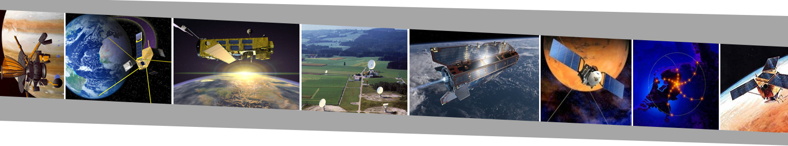
AE2111-II - Aerospace Design and Systems Engineering Elements II
Course Introduction
A. Cervone, F. Oliviero, S. Speretta – Academic Year 2024/25

Slide 2
Introduction Slides – Contents
Course Organization
Objectives and Motivations
Format and Contents
Schedule and Assessment
Aircraft – Introduction
Aircraft lift and drag estimation; high lift devices and aileron sizing
Aircraft weight estimation
Spacecraft – Introduction
Functionalities and Subsystems of Spacecraft
Importance of Systems Engineering

Slide 3
Part 1 Course Organization

Slide 4
Course Lecturers – Spacecraft Part
Angelo Cervone (Space Engineering department)
E-Mail: A.Cervone@tudelft.nl
For questions on the course structure and on the spacecraft part related to Attitude Determination and Control Systems
Stefano Speretta (Space Engineering department)
E-Mail: S.Speretta@tudelft.nl
For questions on the spacecraft part related to Communications

Slide 5
Course Lecturers – Aircraft Part
Fabrizio Oliviero (Flight Performance and Propulsion)
E-Mail: F.Oliviero@tudelft.nl
For general questions on the aircraft topics
E-Mail: AE2111.II.TA@gmail.com
For questions on the aircraft tutorial assignment

Slide 6
Course Objectives and Motivations
Learning Objectives (High-Level)
Identify vehicle subsystems and understand their functionality
Analyze important subsystems
Design top-level subsystems including their operations
Motivations
Analyze and design spacecraft and aircraft systems
Understand some of the common points between aircraft and spacecraft design
Understand both fundamentals and practice
Apply design methodologies to other areas as well

Slide 7


Course Format
Lectures (21 hours)
1 hour intro
10 hours aircraft
10 hours spacecraft
Assessment
Exam
Aircraft Tutorial
Spacecraft Tutorial
You need to enroll on Brightspace for the course (use self-enrollment)
Lecture slides (some with note pages) will be available on Brightspace
There is no reader. Reference books are indicated on the slides.
Attending the lectures is crucial for this course!

Slide 8

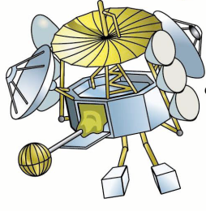
Lecture Plan
Introduction
Sizing of
fixed wing aircraft
Attitude Determination
& Control Subsystem
AIRCRAFT
Lift and drag estimation
HLD and aileron sizing
Weight estimation
Communications
Subsystem
SPACECRAFT

Slide 9
Assessment
Assessment Item | Aircraft Tutorial | Spacecraft Tutorial | Exam
Weight | 1/6 | 1/6 | 4/6
When? | Weeks 1.3-1.7 | Weeks 1.4-1.7 | Week 1.5
Notes | Group assignment (≈5 people per group) | Group assignment (≈5 people per group) | 50% Air 50% Space
All assessment items are mandatory (fail in one of them will result in course fail)
A grade of at least 5.0 must be obtained in each assessment item (if not → course fail)
One re-take will be offered for each assessment item
Course Grade = (1/6)*Air Tutorial + (1/6)*Space Tutorial + (4/6)*Exam
Course Grade is rounded off to 1 decimal
Remember: this course forms a module with AE2111-I (System Design) !
Module grade is calculated combining the two course grades (weighted by number of EC)
⇒ Tutorial and exam results are valid only for A.Y. 2024-2025 (no results will be kept for next A.Y.!)

Slide 10
Assessment: Examples
Case 1
Grade Aircraft tutorial = 7.1
Grade Spacecraft tutorial = 5.8
Grade Written Exam = 5.0
Course Grade = (1/6)*7.1+(1/6)*5.8+(4/6)*5.0 = 5.48 (rounded off to 5.5)
Case 2
Grade Aircraft tutorial = 8.5
Grade Spacecraft tutorial = 3.8
Grade Written Exam = 4.1
Course Grade = 4.1 (in case of course fail, Course Grade = highest grade lower than 5)
Case 3
Grade Aircraft tutorial = 0
(Aircraft tutorial not delivered, including re-take)
Grade Spacecraft tutorial = 5.8
Grade Written Exam = 8.5
Course Grade = 0.0 (in case of course fail, Course Grade = highest grade lower than 5)
PASS
FAIL
FAIL

Slide 11
Dates and Deadlines
Tutorial
Enrol in Brightspace and form groups: September 4th – 16th
Aircraft assignment made available on Brightspace: September 16th
Space assignment made available on Brightspace: September 26th
Deadline for delivering the reports: October 21st
Exam: October 3rd
Re-Sits
Tutorial: December 2024 - January 2025 (exact dates will be announced at a later stage)
Exam: January 2025 (exact date will be announced at a later stage)
⇒ Always keep an eye at Brightspace for announcements!!

Slide 12
Part 2 Aircraft - Introduction

Slide 13
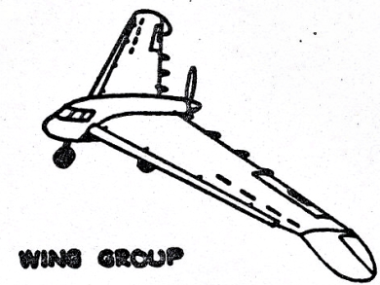
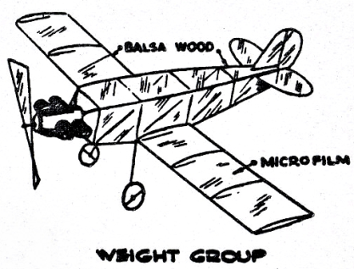
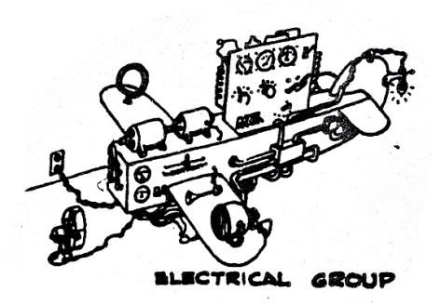
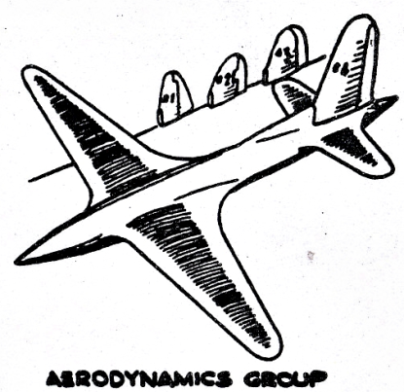
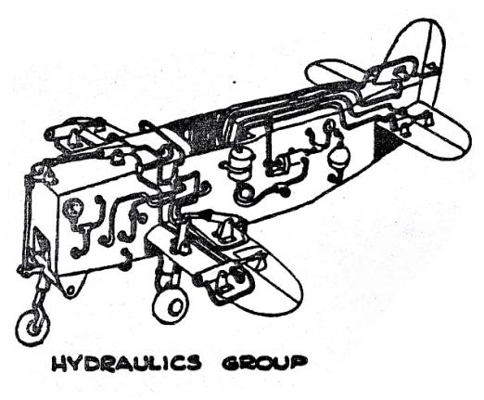
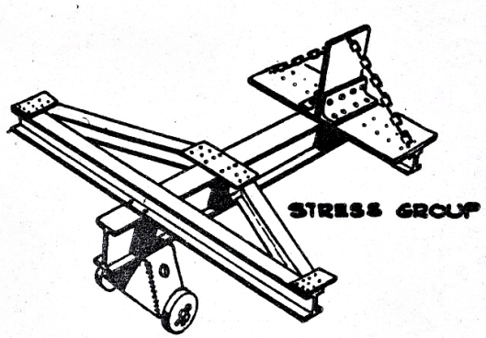
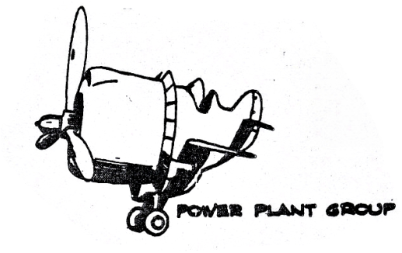
The dream planes…

Slide 14
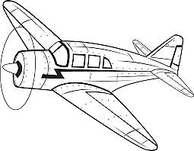
The dream planes…

Slide 15
N2 chart to map the conceptual design process and help manage iterations
Mission definition, fuel fractions
L/D, SFC, OEW/MTOW
Class I weight estimation
OEW, MTOW, Fuel weight
Covered in
AE1222-II
Fuselage sizing
Engine sizing
Wing sizing
tail sizing
gear positioning
Aero analysis
HLD & CS design
L/D, SFC
threeviews
Covered in
This course
Class II weight estimation
OEW
OEW, c.g.
Tail sizing & positioning
Wing positioning
Landing gear positioning
L/D
Tail size and position, wing position, landing gear position

Slide 16
The outcome of AE1222-II
Lateral tipover constraint
Fuel tank
Aerodynamic centers
lateral clearance angle: 7°
CG range
tipback angle: 16°

Slide 17
SE approach to AC design
What are the functions that we are going to explore?
Function
Generate lift
Roll control
Vertical equilibrium
Sub-function
Efficiently @ cruise
Max lift @ low speed
Change in bank angle
Sustain loads
System
Wing
EOW
Sub system
Airfoil and wing planform
HLDs
Aileron
Structural weight

Slide 18
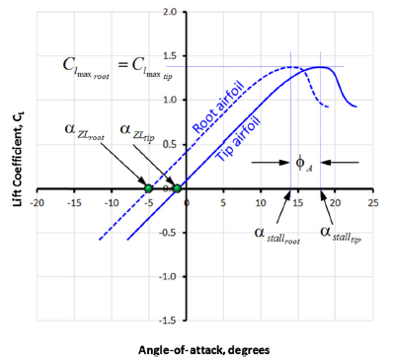
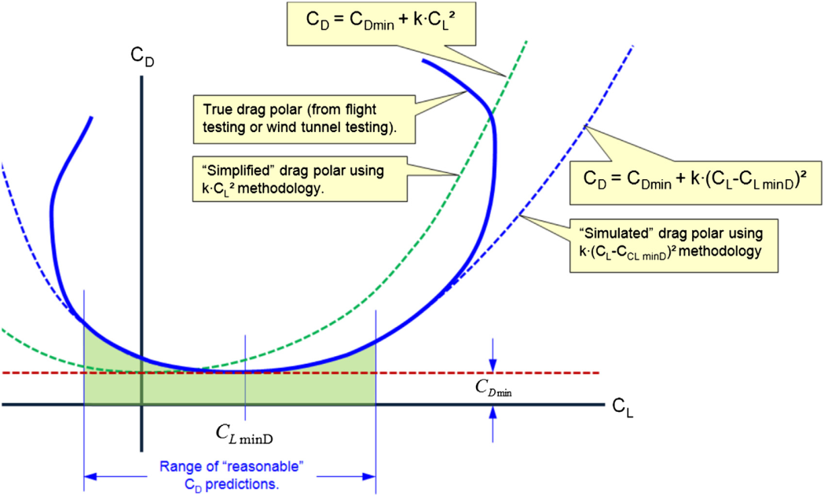
Aircraft aerodynamic analysis - basics
What are the main objectives to be achieved in the aircraft aerodynamic analysis?
Lift curve
Fundamental concepts:
Airfoil aerodynamics
How an airfoil works?
Effect of airfoil shape
Effect of Reynolds number
Effect of Mach number
Wing aerodynamics
3-dimensional effects
Effect of sweep
Effect of aspect ratio and taper ratio
Effect of wing twist
wing stall characteristics
Drag Polar

Slide 19
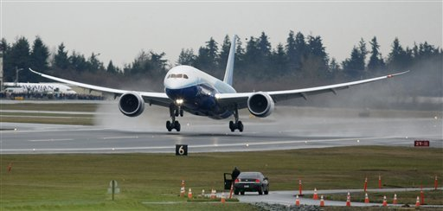
Design of the high lift devices
Why high lift devices?
The wing should be designed to have minimum drag during the cruise, while generating enough lift for take-off and landing.
Are these two design objectives inline?
Unfortunately NO!
So we design HLD!
Type of HLD
Geometry of HLD

Slide 20
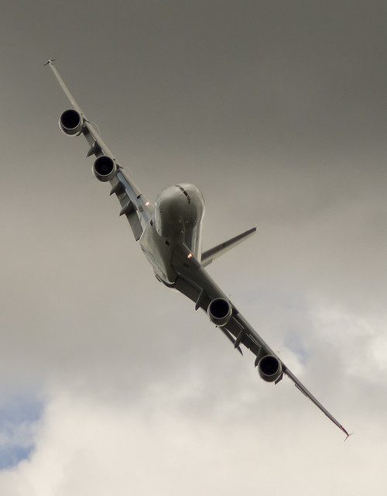
Aileron design
What is the role of aileron?
An aileron is simply a flap usually placed close to the wing tip to control the aircraft roll
How do ailerons work?
Calculation of rolling moments
Definition of stationary design conditions
Sizing of the ailerons

Slide 21
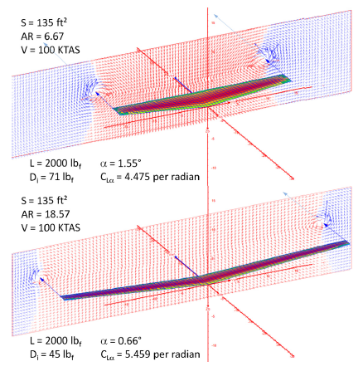


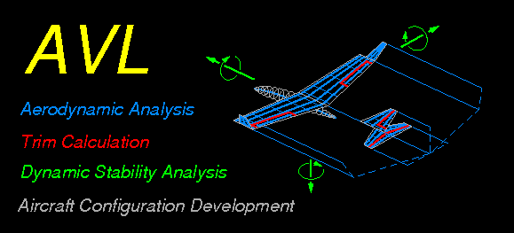
Computational methods for aircraft aerodynamic analysis
What will you learn?
You will learn how to use some simple software to compute aerodynamic characteristics of aircraft.
It will be very useful for you to use them in this course and later in any design exercise!

Slide 22
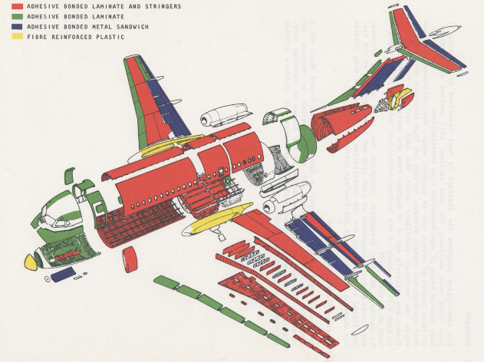
Aircraft weight estimation
What will you learn?
How to estimate the weight of each aircraft component
Wing weight
Fuselage weight
Tail weight
Engine weight
Landing gear weight
Weight of different systems
Avionics
Hydraulic
…

Slide 23
Part 3 Spacecraft - Introduction

Slide 24
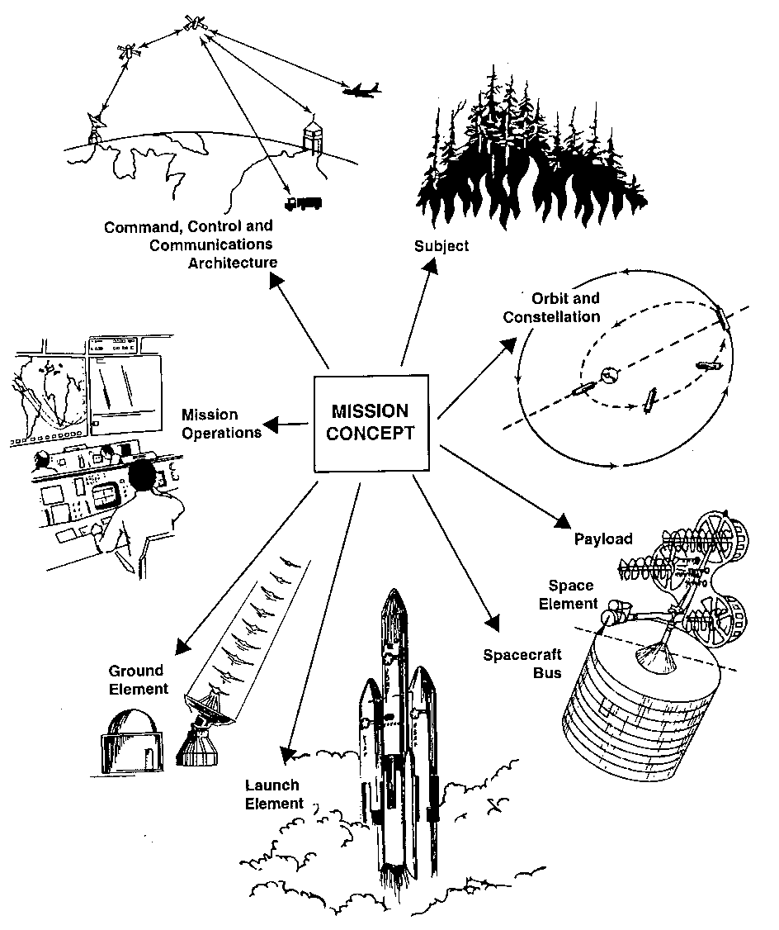
Space Engineering: The Big Picture
This course!
Figure from:
Wertz J.R., Larson W.J. (eds.); Space Mission Analysis and Design ; Microcosm Press, Springer, 3rd edition (2007).
You need to account for all 7 elements of this space mission architecture to be a good space engineer.
Notes:
This picture puts this course in the context of space engineering. Be sure all elements are present when you want to describe a complete mission.
Typically elements like operations are ignored or too lately accounted for.

Slide 25
Space Engineering: Key Functions and Drivers
Payload
Subject
Command,
Control,
Communications,
Mission & Ground
Operations
Launcher
Determine and
control attitude
Process data
Provide structural
integrity
Communicate
Orbit
Determine and
control orbit
Maintain allowed
temperatures
Provide power
Spacecraft bus
Driver from outside the bus
Driver internal to the bus

Slide 26
Spacecraft Bus Functions and Subsystems
Function | Subsystem
Determine and control attitude | Attitude Determination & Control System (ADCS)
Determine and control orbit | Guidance, navigation, control (GNC) Propulsion (Prop)
Provide structural integrity and support launch vehicle interface | Structures and mechanisms
Provide, store, distribute and control electrical power | Electrical Power System (EPS)
Maintain all bus and payload components within their required temperature limits for each mission phase | Thermal Control System (TCS)
Receive, validate, decode and distribute commands to other subsystems and gather, process, and format housekeeping and payload data for downlink | Command & Data Handling System (C&DH), or On-Board Data Handling System (OBDH)
Provide the interface between the spacecraft and other systems | Telecommunications (TC), or Telemetry, Tracking, & Command (TT&C)
Remember: users want functions, NOT subsystems !
Notes:
In another context, a person might want to be transported from A to B. He does NOT necessarily need a car, but just a system which helps getting where he needs.

Slide 27
Spacecraft Bus Functions…
Determine and
control attitude
Process data
Provide structural
integrity
Communicate
Determine and
control orbit
Maintain allowed
temperatures
Provide power

Slide 28
…and Subsystems
ADCS
C&DH
Structures and
Mechanisms
TC
This course
AE2230-II
Propulsion & Power (3rd period)
GNC
Prop
TCS
EPS
ADCS = Attitude Determination & Control System
GNC = Guidance, Navigation and Control
Prop = Propulsion System
EPS = Electrical Power System
TCS = Thermal Control System
C&DH = Command & Data Handling System
TC = Telecommunications System

Slide 29
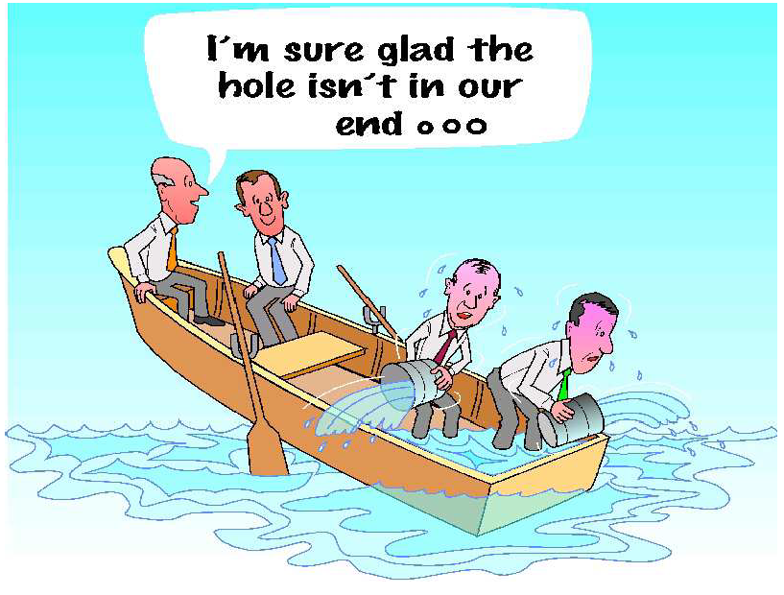
Why Systems Engineering?
To avoid situations like this…
(courtesy of Innovation Associates)

Slide 30

Why Systems Engineering?
…or like this !!
Notes:
Systems Engineering helps us avoid getting “tunnel visions” on an elegant subsystem design that doesn’t meet overall mission objectives. Remember to always focus on the Big Picture of the mission architecture!
The keyword in engineering is BALANCING!

Slide 31
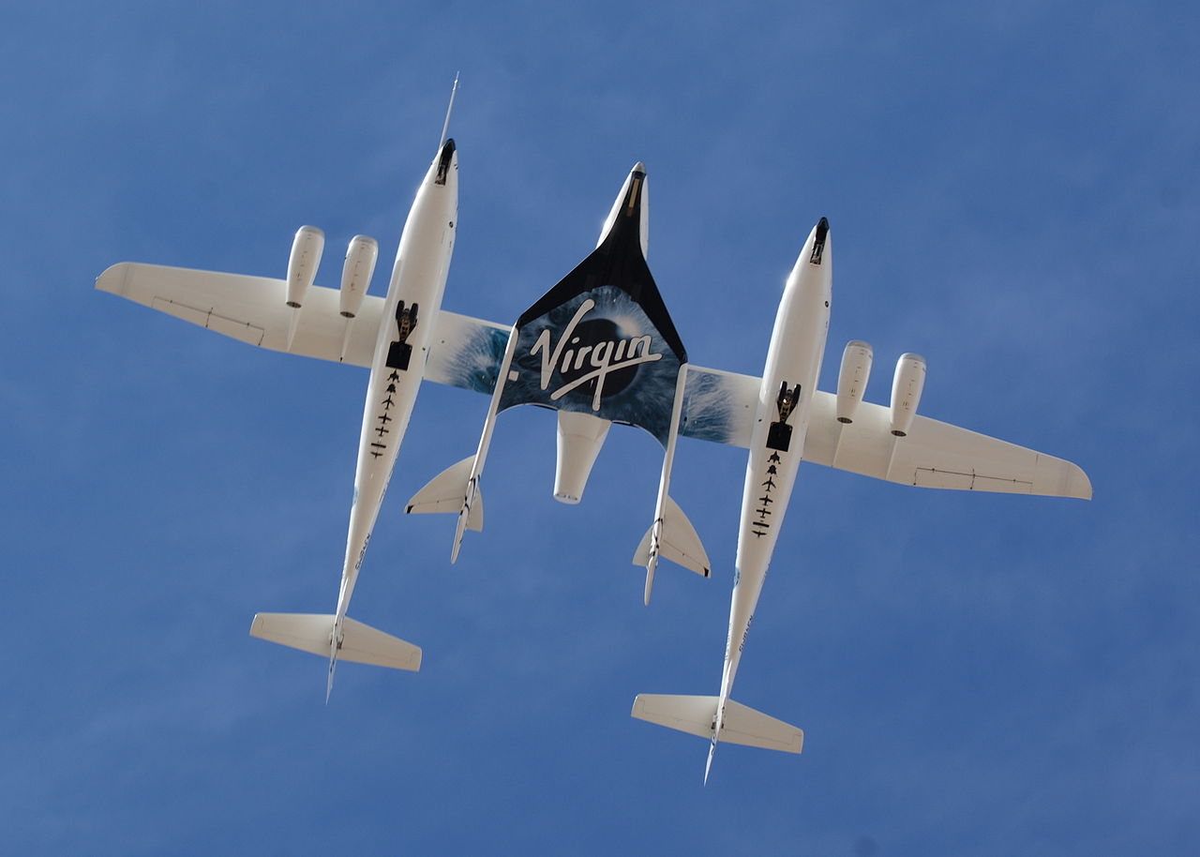
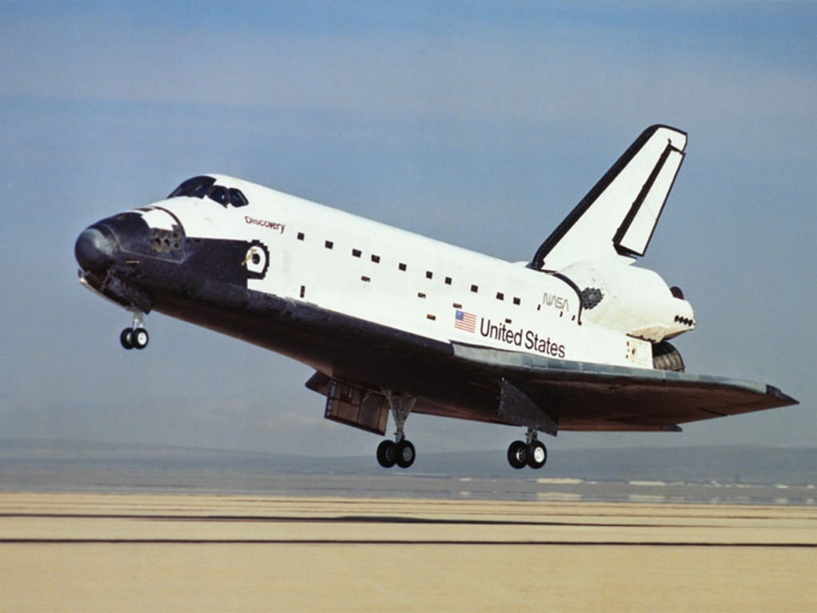
Commonalities Air/Spacecraft Engineering
SpaceShip Two
Space Shuttle
Similar engineering process (Systems Engineering)
Same basic mathematics for usage in models
Sharing use of various disciplines of physics
Systems Engineering is a binding element of Aircraft and Spacecraft engineering

Slide 32

Thank you! Questions?
Angelo Cervone
Space Engineering Department
Delft University of Technology
Your feedback is welcome!

